Slide 1
dbatools 1.0 Updated, Cross Platform and ready for Production use.
Patrick Flynn
Almost

Slide 2
Thank you to our sponsors:

Slide 3
Evaluations:

Slide 4

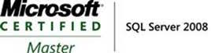


Patrick Flynn SQL Server DBA Link Group
MCM – SQL Server 2008
MCSM – Data Platform
Production DBA for 10+ years.
https://github.com/sqllensman/Presentations
patrick@sqllensman.com
@sqllensman
Patrick Flynn

Slide 5
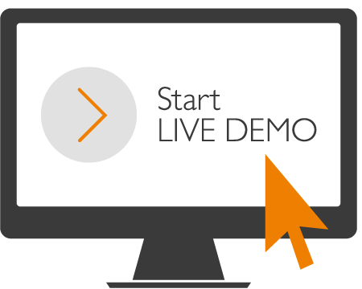
DEMOS
Notes:
SQL DB uses Public VMs hosting database engine
Managed Instance – Tenant Isolation via use of own dedicated VM’s that are injected into Customer VNet

Slide 6


Slide 7
dbatools
Main Site
https://dbatools.io
Getting Started
https://dbatools.io
Commands
https://dbatools.io/commands/
Blog
https://dbatools.io/blog/
Video
https://sqlbits.com/Sessions/Event17/Simplifying_XEvents_Management_with_dbatools
https://sqlbits.com/Sessions/Event18/Simplifying_Disaster_Recovery_using_dbatools

Slide 8


Slide 9


